Slide 1


Slide 2
Lecture By Arjun Pukale

Slide 3

Mathematics behind Gradient Descent Learning Algorithm
Part-1

Slide 4
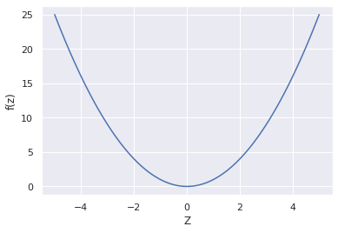

$$f\left(z\right)=z^{2}$$
Goal: Find the value of z such that f(z) is minimum

Slide 5
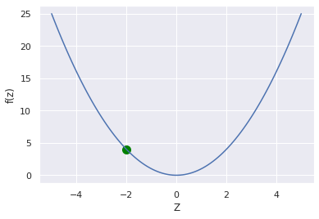
$$f\left(z\right)=z^{2}$$
Goal: Find the value of z such that f(z) is minimum
Randomly initialize value of z

Slide 6
$$f\left(z\right)=z^{2}$$
Target

Slide 7
$$f\left(z\right)=z^{2}$$
Use Slope to update the value of z
Target

Slide 8
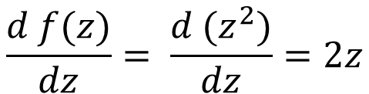
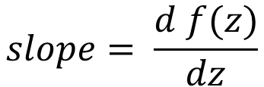

$$f\left(z\right)=z^{2}$$
$$f\left(z\right)=z^{2}$$
$$slope= \frac{d f(z)}{dz}$$
$$\frac{d f(z)}{dz}= \frac{d (z^{2})}{dz}=2z$$
slope
Target

Slide 9
$$f\left(z\right)=z^{2}$$
$$f\left(z\right)=z^{2}$$
$$slope= \frac{d f(z)}{dz}$$
$$\frac{d f(z)}{dz}= \frac{d (z^{2})}{dz}=2z$$
-ve slope
Target

Slide 10
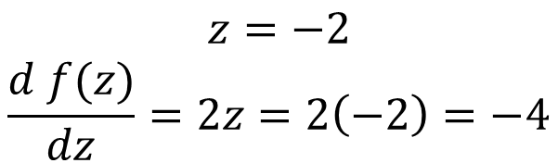
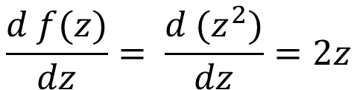
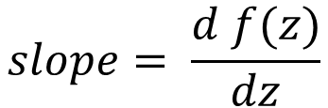

$$f\left(z\right)=z^{2}$$
$$f\left(z\right)=z^{2}$$
$$slope= \frac{d f(z)}{dz}$$
$$\frac{d f(z)}{dz}= \frac{d (z^{2})}{dz}=2z$$
-ve slope
$$z=−2$$
$$\frac{d f(z)}{dz}=2z=2\left(−2\right)=−4$$
Target

Slide 11
$$f\left(z\right)=z^{2}$$
$$f\left(z\right)=z^{2}$$
$$slope= \frac{d f(z)}{dz}$$
$$\frac{d f(z)}{dz}= \frac{d (z^{2})}{dz}=2z$$
-ve slope
$$z=−2$$
$$\frac{d f(z)}{dz}=2z=2\left(−2\right)=−4$$
Target
Increase or decrease z ?

Slide 12
$$f\left(z\right)=z^{2}$$
$$f\left(z\right)=z^{2}$$
$$slope= \frac{d f(z)}{dz}$$
$$\frac{d f(z)}{dz}= \frac{d (z^{2})}{dz}=2z$$
-ve slope
$$z=−2$$
$$\frac{d f(z)}{dz}=2z=2\left(−2\right)=−4$$
Target
Increase z

Slide 13
$$f\left(z\right)=z^{2}$$
$$f\left(z\right)=z^{2}$$
$$slope= \frac{d f(z)}{dz}$$
$$\frac{d f(z)}{dz}= \frac{d (z^{2})}{dz}=2z$$
-ve slope
$$z=−2$$
$$\frac{d f(z)}{dz}=2z=2\left(−2\right)=−4$$
Target
Update z in opposite direction of slope!

Slide 14

$$f\left(z\right)=z^{2}$$
$$f\left(z\right)=z^{2}$$
$$slope= \frac{d f(z)}{dz}$$
$$\frac{d f(z)}{dz}= \frac{d (z^{2})}{dz}=2z$$
-ve slope
$$z=−2$$
$$\frac{d f(z)}{dz}=2z=2\left(−2\right)=−4$$
Target
$z=z−$ $\frac{d f(z)}{dz}$
Update z in opposite direction of slope!

Slide 15
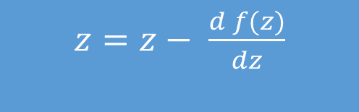
$$f\left(z\right)=z^{2}$$
$$f\left(z\right)=z^{2}$$
$$slope= \frac{d f(z)}{dz}$$
$$\frac{d f(z)}{dz}= \frac{d (z^{2})}{dz}=2z$$
-ve slope
$$z=−2$$
$$\frac{d f(z)}{dz}=2z=2\left(−2\right)=−4$$
Target
$z=z−$ $\frac{d f(z)}{dz}$
$z=z−$ $\frac{d f(z)}{dz}$

Slide 16

$$f\left(z\right)=z^{2}$$
$$f\left(z\right)=z^{2}$$
$$slope= \frac{d f(z)}{dz}$$
$$\frac{d f(z)}{dz}= \frac{d (z^{2})}{dz}=2z$$
-ve slope
$$z=−2$$
$$\frac{d f(z)}{dz}=2z=2\left(−2\right)=−4$$
Target
$$z=z−(−4)$$
$z=z−$ $\frac{d f(z)}{dz}$

Slide 17

$$f\left(z\right)=z^{2}$$
$$f\left(z\right)=z^{2}$$
$$slope= \frac{d f(z)}{dz}$$
$$\frac{d f(z)}{dz}= \frac{d (z^{2})}{dz}=2z$$
-ve slope
$$z=−2$$
$$\frac{d f(z)}{dz}=2z=2\left(−2\right)=−4$$
Target
$$z=−2−(−4)$$
$z=z−$ $\frac{d f(z)}{dz}$

Slide 18

$$f\left(z\right)=z^{2}$$
$$f\left(z\right)=z^{2}$$
$$slope= \frac{d f(z)}{dz}$$
$$\frac{d f(z)}{dz}= \frac{d (z^{2})}{dz}=2z$$
-ve slope
$$z=−2$$
$$\frac{d f(z)}{dz}=2z=2\left(−2\right)=−4$$
Target
$$z=2$$
$z=z−$ $\frac{d f(z)}{dz}$

Slide 19
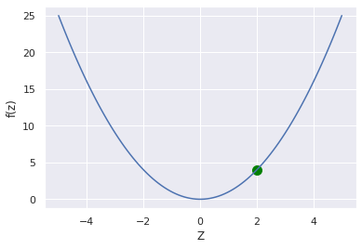
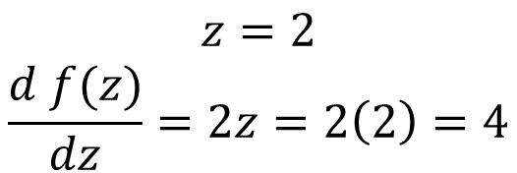
$$f\left(z\right)=z^{2}$$
$$f\left(z\right)=z^{2}$$
$$slope= \frac{d f(z)}{dz}$$
$$\frac{d f(z)}{dz}= \frac{d (z^{2})}{dz}=2z$$
-ve slope
$$z=2$$
$$\frac{d f(z)}{dz}=2z=2\left(2\right)=4$$
$z=z−$ $\frac{d f(z)}{dz}$

Slide 20
$$f\left(z\right)=z^{2}$$
$$f\left(z\right)=z^{2}$$
$$slope= \frac{d f(z)}{dz}$$
$$\frac{d f(z)}{dz}= \frac{d (z^{2})}{dz}=2z$$
+ve slope
-ve slope
$$z=2$$
$$\frac{d f(z)}{dz}=2z=2\left(2\right)=4$$
$z=z−$ $\frac{d f(z)}{dz}$

Slide 21
$$f\left(z\right)=z^{2}$$
$$f\left(z\right)=z^{2}$$
$$slope= \frac{d f(z)}{dz}$$
$$\frac{d f(z)}{dz}= \frac{d (z^{2})}{dz}=2z$$
+ve slope
-ve slope
$$z=2$$
$$\frac{d f(z)}{dz}=2z=2\left(2\right)=4$$
Decrease z
$z=z−$ $\frac{d f(z)}{dz}$

Slide 22

$$f\left(z\right)=z^{2}$$
$$f\left(z\right)=z^{2}$$
$$slope= \frac{d f(z)}{dz}$$
$$\frac{d f(z)}{dz}= \frac{d (z^{2})}{dz}=2z$$
+ve slope
-ve slope
$$z=2$$
$$\frac{d f(z)}{dz}=2z=2\left(2\right)=4$$
$z=z−$ $4$
$z=z−$ $\frac{d f(z)}{dz}$

Slide 23

$$f\left(z\right)=z^{2}$$
$$f\left(z\right)=z^{2}$$
$$slope= \frac{d f(z)}{dz}$$
$$\frac{d f(z)}{dz}= \frac{d (z^{2})}{dz}=2z$$
+ve slope
-ve slope
$$z=2$$
$$\frac{d f(z)}{dz}=2z=2\left(2\right)=4$$
$z=2−$ $4$
$z=z−$ $\frac{d f(z)}{dz}$

Slide 24

$$f\left(z\right)=z^{2}$$
$$f\left(z\right)=z^{2}$$
$$slope= \frac{d f(z)}{dz}$$
$$\frac{d f(z)}{dz}= \frac{d (z^{2})}{dz}=2z$$
-ve slope
$$z=2$$
$$\frac{d f(z)}{dz}=2z=2\left(2\right)=4$$
$$z=−2$$
$z=z−$ $\frac{d f(z)}{dz}$

Slide 25

$$f\left(z\right)=z^{2}$$
$$f\left(z\right)=z^{2}$$
$$slope= \frac{d f(z)}{dz}$$
$$\frac{d f(z)}{dz}= \frac{d (z^{2})}{dz}=2z$$
-ve slope
$$z=−2$$
$$\frac{d f(z)}{dz}=2z=2\left(−2\right)=−4$$
$$z=−2−\left(−4\right)=2$$
$z=z−$ $\frac{d f(z)}{dz}$

Slide 26
$$f\left(z\right)=z^{2}$$
$$f\left(z\right)=z^{2}$$
$$slope= \frac{d f(z)}{dz}$$
$$\frac{d f(z)}{dz}= \frac{d (z^{2})}{dz}=2z$$
+ve slope
-ve slope
$$z=−2$$
$$\frac{d f(z)}{dz}=2z=2\left(−2\right)=−4$$
Control the update size!!!
$$z=−2−\left(−4\right)=2$$
$z=z−$ $\frac{d f(z)}{dz}$

Slide 27
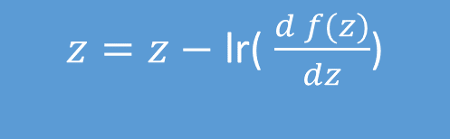
$$f\left(z\right)=z^{2}$$
$$f\left(z\right)=z^{2}$$
$$slope= \frac{d f(z)}{dz}$$
$$\frac{d f(z)}{dz}= \frac{d (z^{2})}{dz}=2z$$
+ve slope
-ve slope
Control the update size by using a learning rate.
Learning rate is usually set less than 1
Eg 0.5, 0.1, 0.01, 0.05…..
New Update Rule:
$z=z−$ lr( $\frac{d f(z)}{dz}$)

Slide 28

$$f\left(z\right)=z^{2}$$
$$f\left(z\right)=z^{2}$$
$$slope= \frac{d f(z)}{dz}$$
$$\frac{d f(z)}{dz}= \frac{d (z^{2})}{dz}=2z$$
$$z=−2$$
$$\frac{d f(z)}{dz}=2z=2\left(−2\right)=−4$$
$z=z−$ lr( $\frac{d f(z)}{dz}$)
lr=0.1
$$z=z−0.1(−4)$$

Slide 29

$$f\left(z\right)=z^{2}$$
$$f\left(z\right)=z^{2}$$
$$slope= \frac{d f(z)}{dz}$$
$$\frac{d f(z)}{dz}= \frac{d (z^{2})}{dz}=2z$$
$$z=−2$$
$$\frac{d f(z)}{dz}=2z=2\left(−2\right)=−4$$
$z=z−$ lr( $\frac{d f(z)}{dz}$)
lr=0.1
$$z=z+0.4$$

Slide 30

$$f\left(z\right)=z^{2}$$
$$f\left(z\right)=z^{2}$$
$$slope= \frac{d f(z)}{dz}$$
$$\frac{d f(z)}{dz}= \frac{d (z^{2})}{dz}=2z$$
$$z=−2$$
$$\frac{d f(z)}{dz}=2z=2\left(−2\right)=−4$$
$z=z−$ lr( $\frac{d f(z)}{dz}$)
lr=0.1
$$z=−2+0.4$$

Slide 31
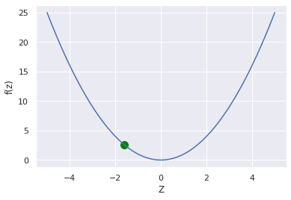

$$f\left(z\right)=z^{2}$$
$$f\left(z\right)=z^{2}$$
$$slope= \frac{d f(z)}{dz}$$
$$\frac{d f(z)}{dz}= \frac{d (z^{2})}{dz}=2z$$
$$z=−2$$
$$\frac{d f(z)}{dz}=2z=2\left(−2\right)=−4$$
$z=z−$ lr( $\frac{d f(z)}{dz}$)
lr=0.1
$$z=−1.6$$

Slide 32
Learning rate: 0.1 , Iterations: 10

Slide 33
Learning rate: 0.01 , Iterations: 10

Slide 34
Learning rate: 0.8 , Iterations: 10

Slide 35
Learning rate: 1.1 , Iterations: 5

Slide 36
Lr=0.01
Lr=0.1
Lr=0.8
Lr=1.1
Code to implement this is in the description

Slide 37



